Slide 1
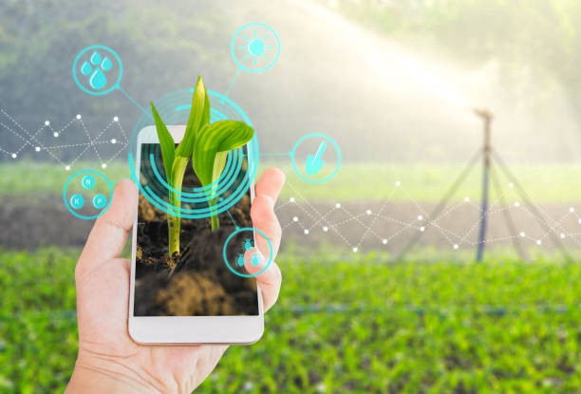
E- Farmer Portal One stop solution for agriculture

Slide 2
Introduction
In our day to day life we consume food and our survival is based mainly on food in which a considerable amount of it is coming from farms.
Farmers do their hard work for growing and serving many lives across the country, which pays for their source of income. But due to intermediates in selling their final products, farmers are unable to make their profit and mostly live poor.
By this project we will be able to connect farmers directly to the customer so that direct dealing of products can be accomplished. This will result in a significant decrease in the prices of the products currently available in the market as well as the profit will directly reach the farmers pocket.
We are surrounded by technology but there are many people who are still unaware of the benefits of this technology or its use, by the help of this project and the support for the awareness of the project, many farmers will be able to use as well as will be taught how to use this application with its benefits.

Slide 3
Objectives
Better price and bargaining power to farmers
Access to more markets for the buyer
It increases competitiveness
It establishes quality assaying systems
It gives the real time information of prices and trades
It has transparent and quick financial transactions
Easy to use as language change option is also available

Slide 4
Abstract
In the E-Farmer Portal, farmer can see all the details like Farmer details, Crop details, Land details, loan and subsidy details
it is also a market place where a farmer can sell his crop from a click and can also buy seeds, agriculture instruments.
Information section regarding latest farming, Organic farming etc will be provided for farmer and a farmer community section where a farer can connect with another farmer in the same area.
Farmer can fix the rates of the products.
Buyer gets the username and password by filling the registration form. They can view all the details of the product.
We will also provide information about Schemes, Services of agriculture provided by Government for farmers.
We will also update information about weather for farmers
We will also tell the importance of Home Farming in our Portal

Slide 5
Existing and Proposed System
In the existing system, buying and selling a product is done manually. Price of the product is fixed by the seller. All the details of the product to be sold or purchased is maintained manually. Sellers or buyers are not able to get the complete information about the product.
In the proposed system, buyers or sellers can directly register in the site and sell/buy the product otherwise they can contact with a seller directly. Buyers can open the site and register with it and sell their products online. E-farmer Portal is a project that builds a website which will help farmers to sell their their products in different cities online. Also additional information regarding home farming is also given in our website.

Slide 6
Technology Used
In this project , for front end development we use HTML,CSS and bootstrap
We Predict the weather using Machine learning Algorithms
For Back end development , we use php to give database connection.

Slide 7
Conclusion
We conclude that this project will be useful not only to the farmers but also to the buyers as it is very easy to buy the necessary items. Also it gives information about the tips and techniques to grow home farming. As there is also language change options, many people can make use of the website.

Slide 8
THANK YOU...
Sree Keerthi Meghana.B
Gayatri Gayatri
Sai Tharun Chiluveru

